Slide 1

FAKE NEWS SENTIMENT ANALYSIS
TEAM NAME: TRISHUL
DATE: 26 June 2023

Slide 2

INTRODUCTION:
One of the major and most growing concerns today, affecting individuals and societies.
False information or rumors spread deceptively, posing threats to social well-being.

Slide 3
What is Fake News?
False or misleading information presented as news or factual reporting.
Intentionally created or spread with the intention to deceive or misinform readers.
Can be found in various forms, such as fabricated stories, manipulated images or videos, or exaggerated claims.

Slide 4
Types of News
Disinformation: Deliberate spreading of false or misleading information with the intent to deceive or manipulate.
Fake news: False or misleading information presented as news, often created to mislead or generate attention.
Misinformation: False or inaccurate information shared unintentionally, without malicious intent.

Slide 5
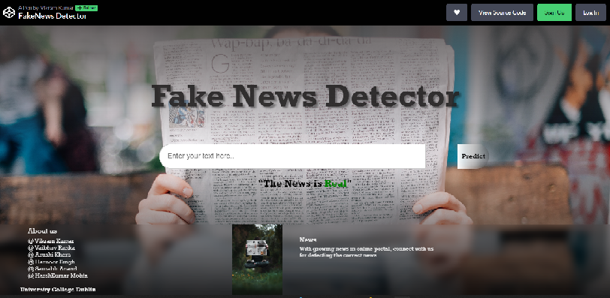
Overview of project objectives
Main Objective:
To create a model for FAKE NEWS SENTIMENT ANALYSIS. To analyse if the misinformation spread across social media, articles etc is real or fake.
We are building a model, for end-to-end user connectivity, where a user can put some text or headline of news and the model helps in detecting whether it is fake or real.
Target audience: Anyone who consume news and information online through any of the social media platform, organisation, articles etc.

Slide 6

Need: A lot of fake news during covid mislead people, created a situation of panic. Social media and news articles are full of fake news about celebrities, political events, health-care etc. This leads to fear and confusion.
News should be true to:
1. Preserve the truth
2. Protect public discourse
3. Prevent Harm
4. Promote critical thinking
5. Build trust in informational sources
This semester, Simon is giving A+ grade to everybody.
True News?
Fake News?

Slide 7
 | Real News | Fake News
1. | Comes from a respected news outlet | Comes from an unfamiliar resource
2. | Headline matches the rest of the article | Headline is outrageous or does not match article.
3. | URL matches the news source. | URL looks strange and doesn’t match the news outlet
4. | Has a real time / current date. | Either old date or no date coverage
The challenge:
To build a sustainable model, giving a good accuracy in predicting the fake news and analysing sentiments, giving a reliable information to our users.

Slide 8
Technology Stack
Key Technologies:
Back-end: MySQL, FLASK,
Front-end (website): HTML with markdown preprocessor, CSS with SCSS preprocessor and normalise base, JavaScript with Babel Preprocessor
ML modelling: Naïve Bayes, KNN, Linear Regression, Logistic Regression, Support Vector Machine, Random Forest
Python libraries: pandas, numpy, sklearn, matplotlib, tensorflow
Deep learning modelling: CNN
AWS cloud: EC2, S3, RDS

Slide 9
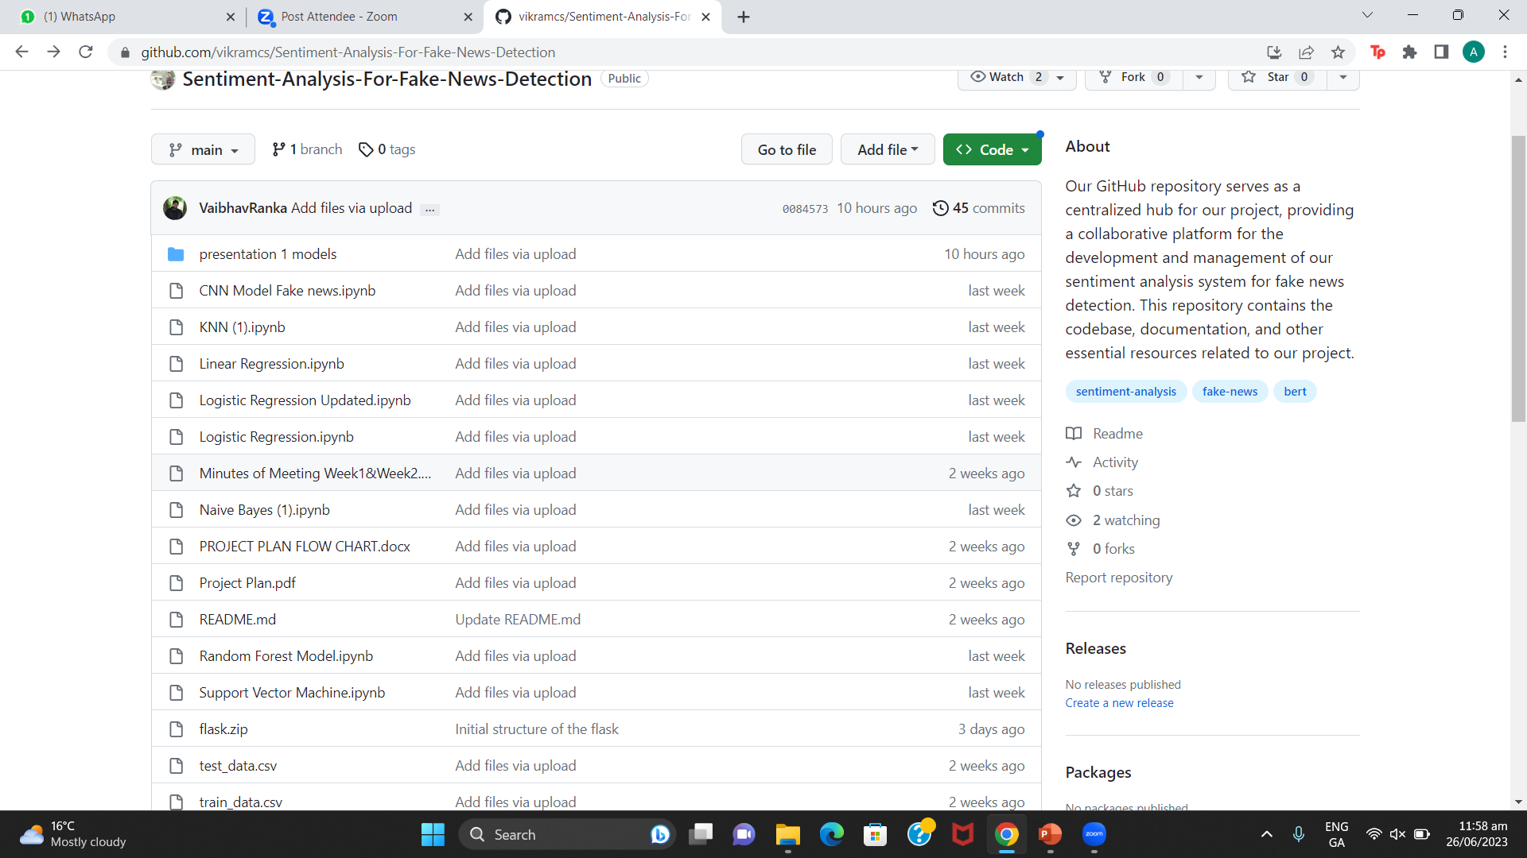
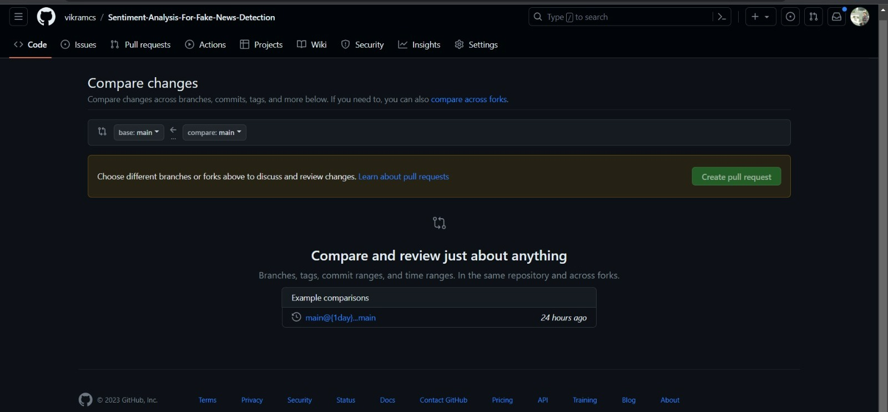
Data Sources
Data source: Git Hub: https://github.com/UNHSAILLab/SentimentalLIAR
We will be splitting the data into our training and testing model, for running of our model and getting the accuracy.
The data is stored in the format of CSV(excel files), which will be read later in a python notebook.

Slide 10
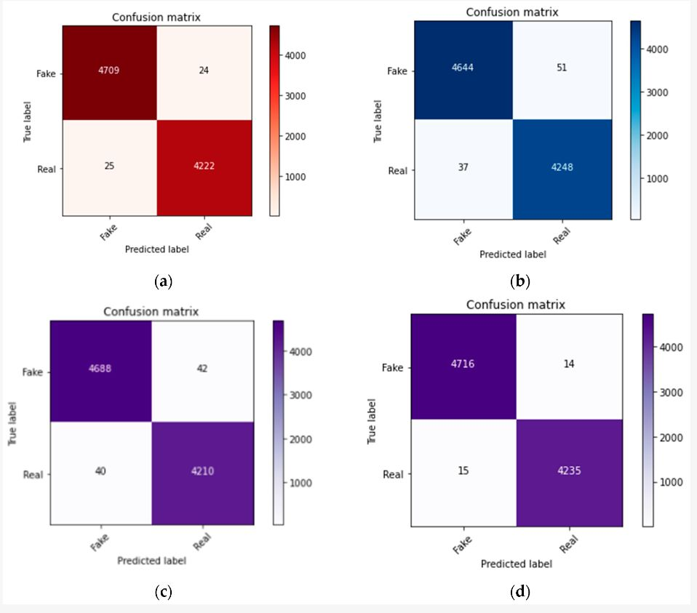
Evaluation
We are using some measures as:
Confusion Matrix (TP, TN, FP, FN, Accuracy, Precision, Recall, Rate, Specificity )
F1 Score
RMSE value
Visualisations (Training v/s Testing, ROC Curve, AOC Curve)

Slide 11
Current Status
Technical Progress:
Gathered dataset, cleaned and pre-processed it.
Divided it into train data and test data.
Trained ML and Deep Learning models on it to test the accuracy.
Worked on the front-end: website prototype.
AWS S3 deployment with twitter API.
Management Status:
Daily meetings to discuss progress and plan for the next day.
Assignment of task on ClickUp.

Slide 12
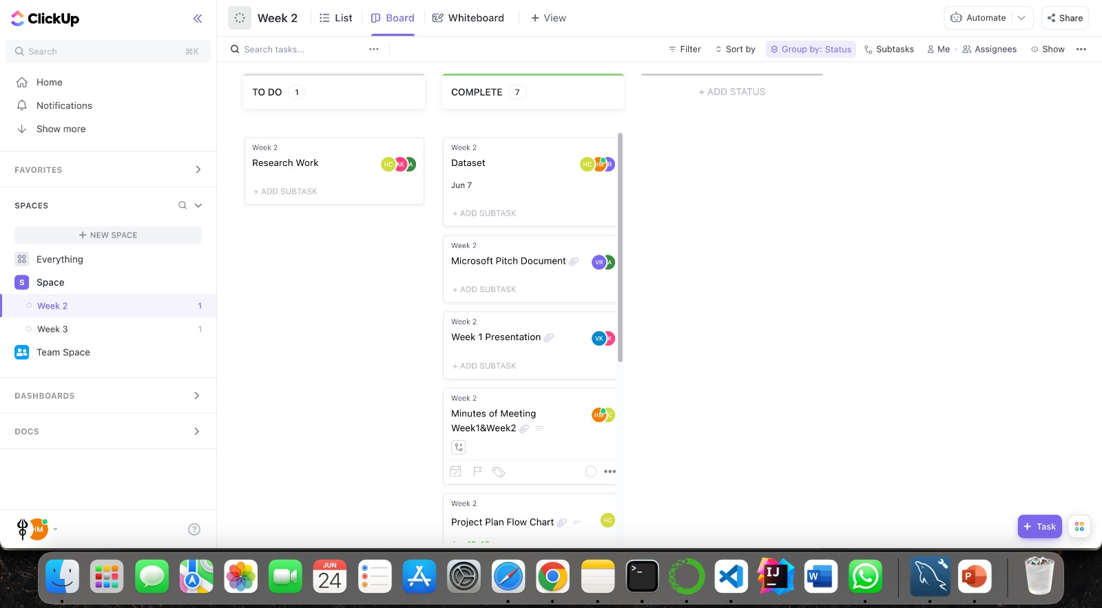
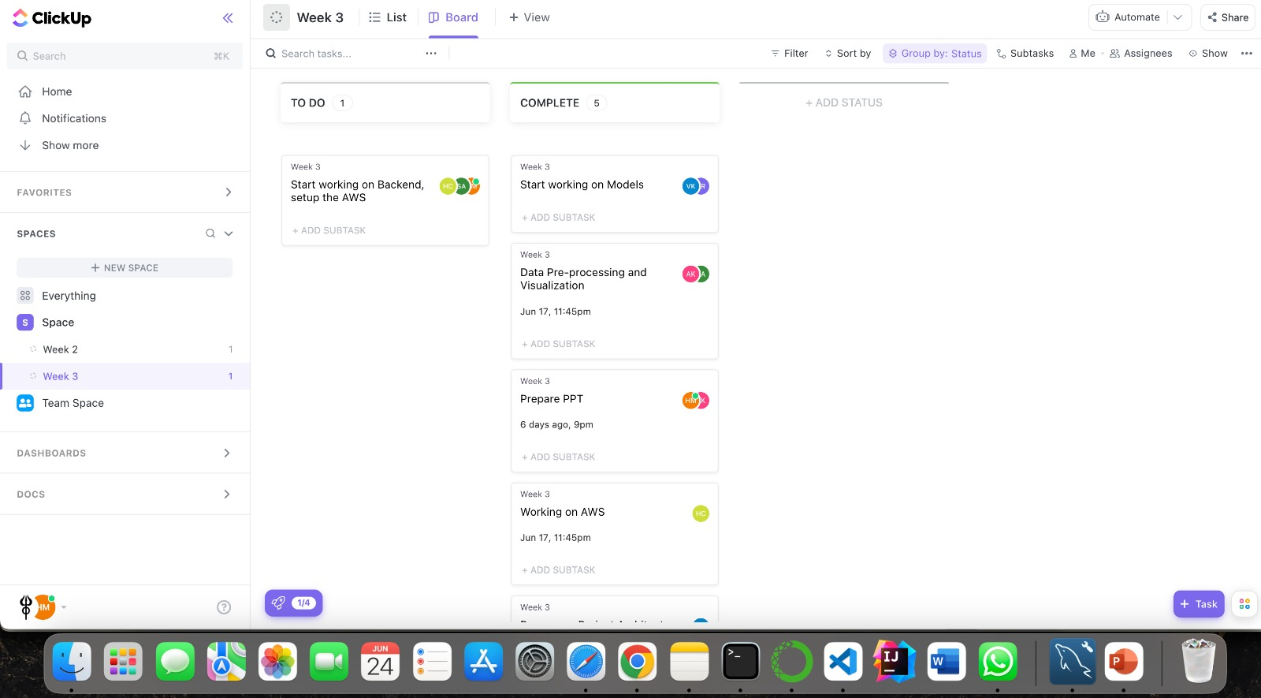
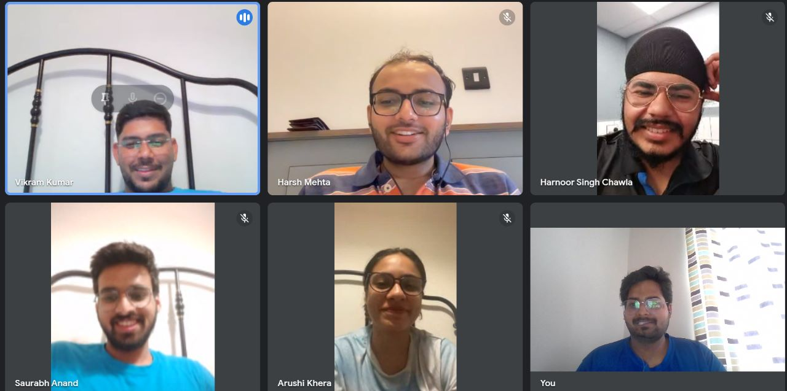
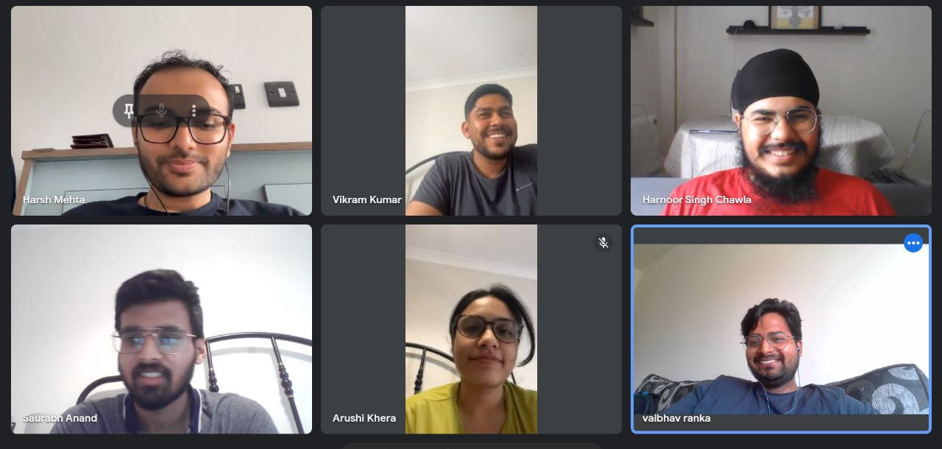

Slide 13
Sprint Plan
Sprint 1 Week 1 - Week 2 | Conduct research on sentiment analysis techniques and fake news detection algorithms. Define project requirements and specifications. Set up the development environment and establish version control. Assign roles and responsibilities to team members.
Sprint 2 Week 3 – Week 4 | Train machine learning models using labelled datasets. Develop basic front-end prototype using HTML, CSS, and JavaScript. AWS S3 and RDS initial setup Implement basic server-side functionality for data storage and retrieval.
Sprint 3 Week 5 - Week 6 | Integrate the front-end and back-end components of the system. Implement the back-end functionality for sentiment analysis and fake news detection. Conduct comprehensive testing to ensure accuracy and reliability.
Sprint 4 Week 7 – Week 8 | Implement real-time analysis capabilities. Perform system testing and debugging. Enhance the user interface and improve user experience
Sprint 5 Week 9 – Week 10 | Conduct thorough performance testing and optimization. Address any remaining bugs or issues. Finalize documentation, including user guides and technical documentation. Prepare for the final presentation and demo.

Slide 14
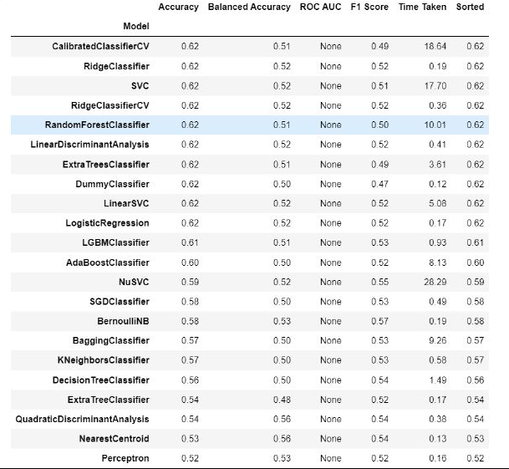
Model Selection
Chosen certain set of models based on the accuracy parameter as shown in the screenshot such as SVC, Random Forest, Logistic Regression, KNN

Slide 15
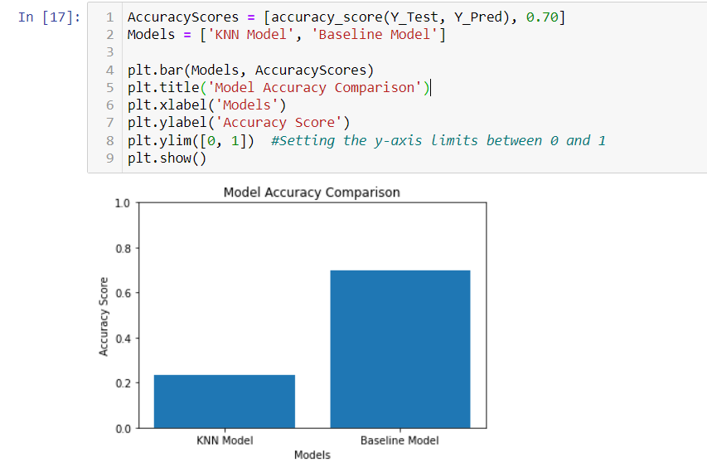
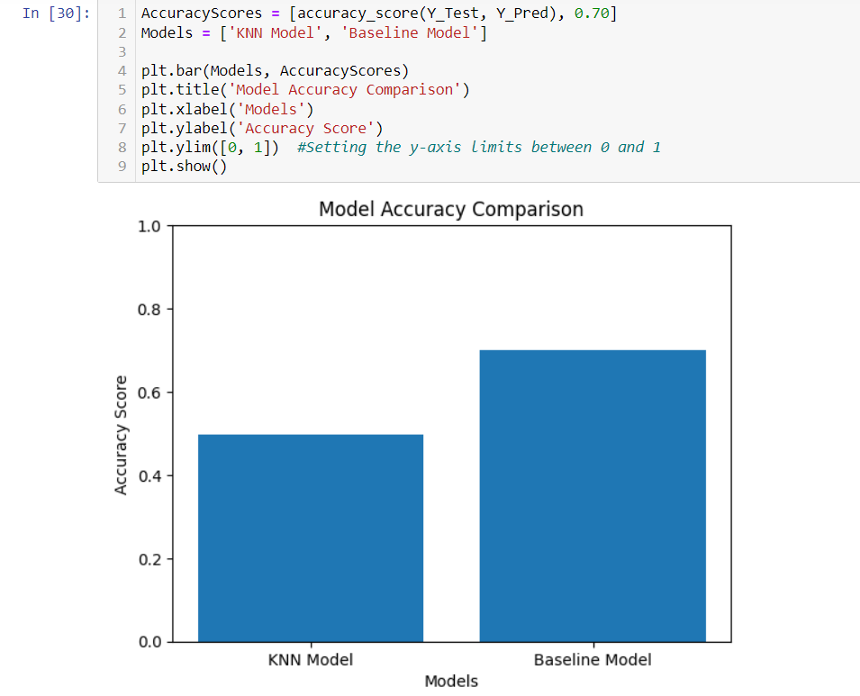
Comparing accuracy of model
Accuracy: 23.38%
Accuracy: 60.75%

Slide 16
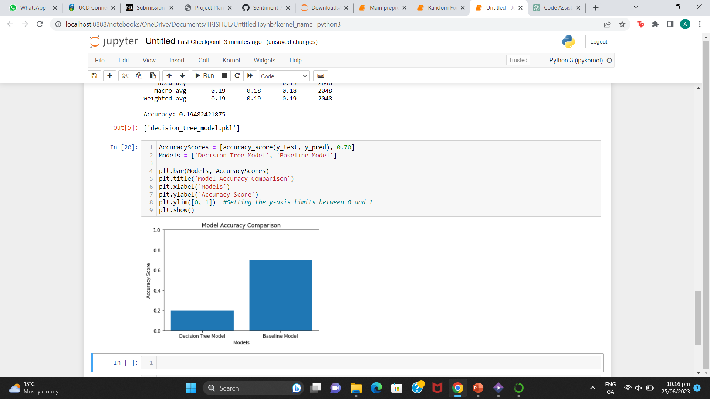
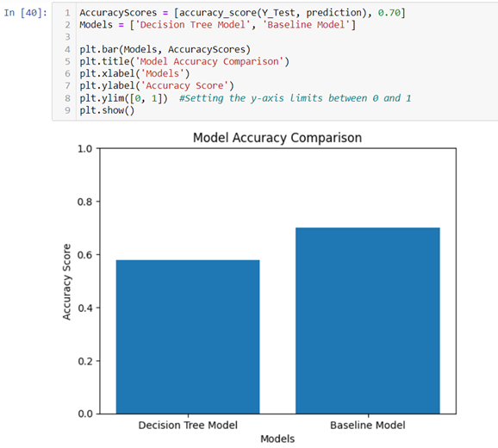
Accuracy: 19.48%
Accuracy: 57.90%

Slide 17
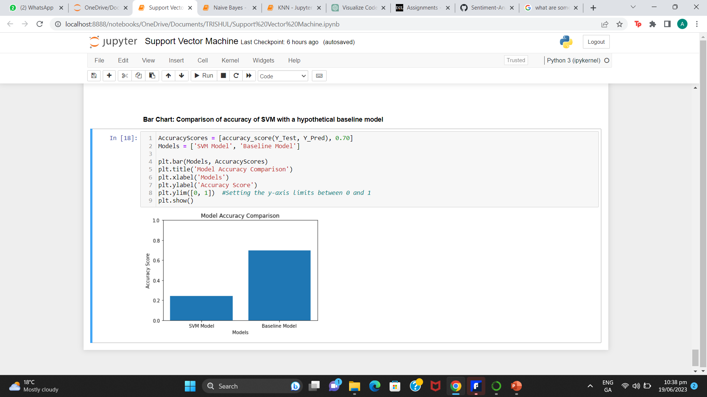
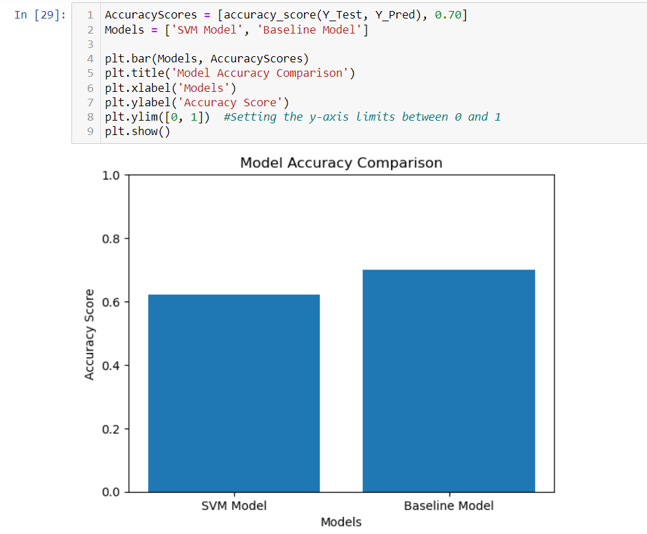
Accuracy: 24.41%
Accuracy: 62.07%

Slide 18
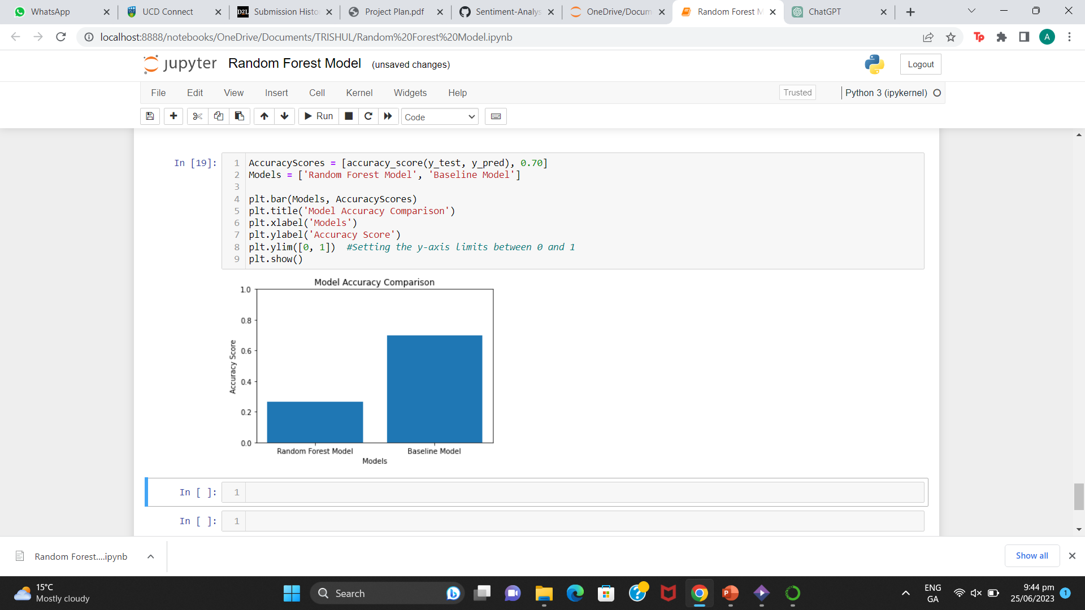
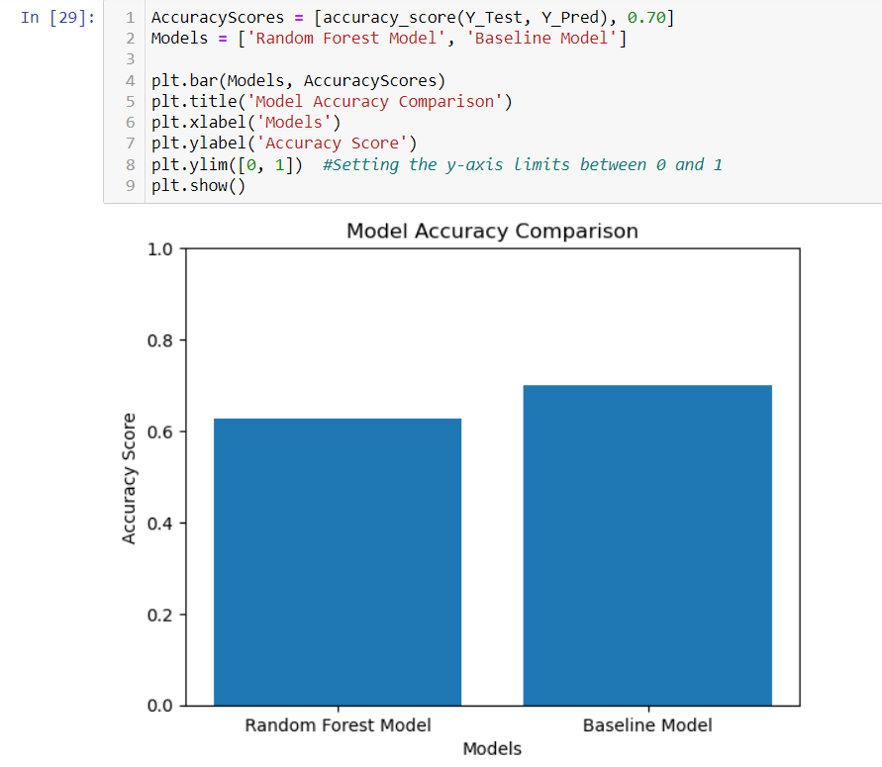
Accuracy: 25.92%
Accuracy: 62.70%

Slide 19
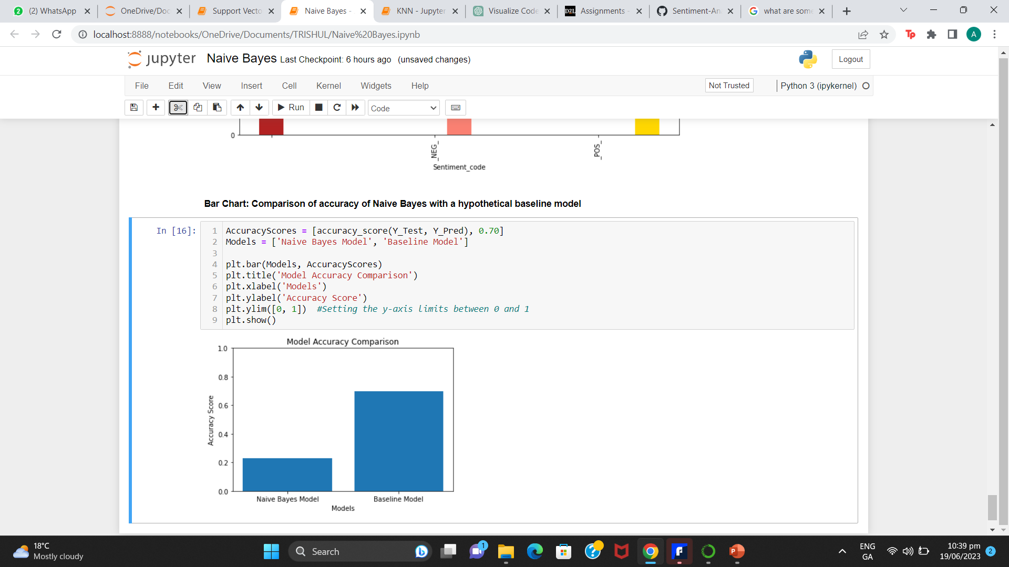
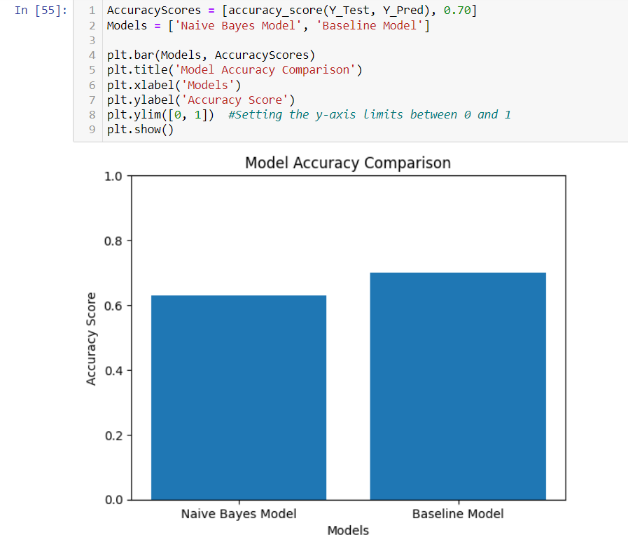
Accuracy: 22.75%
Accuracy: 62.90%

Slide 20
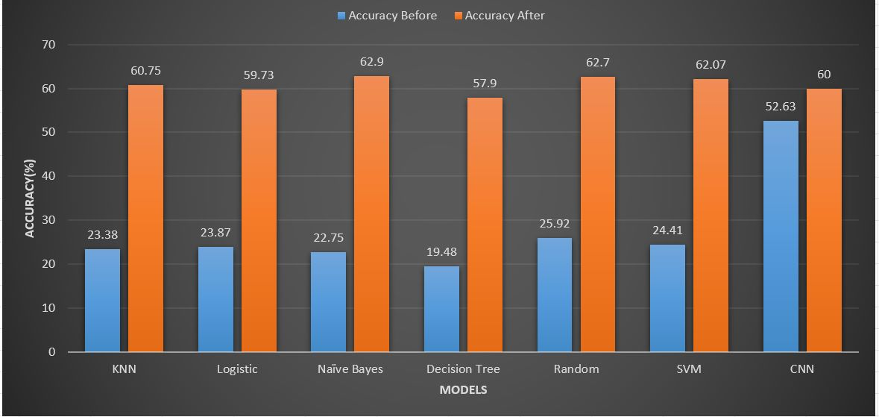

Slide 21
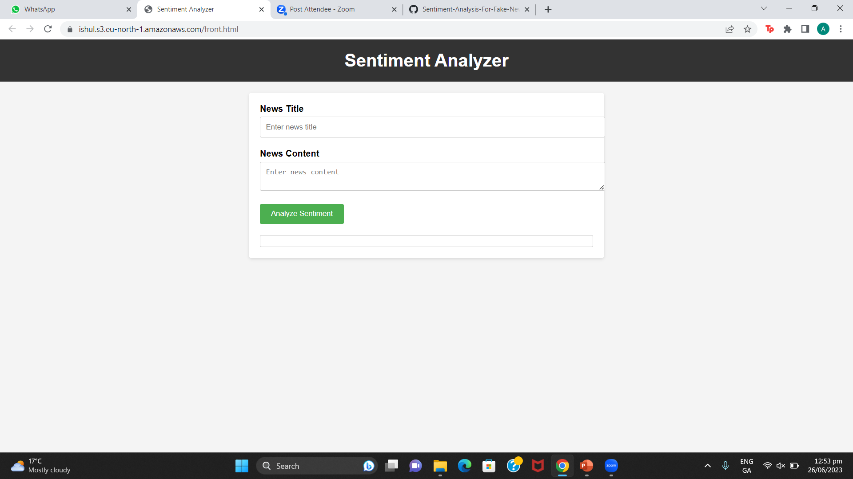
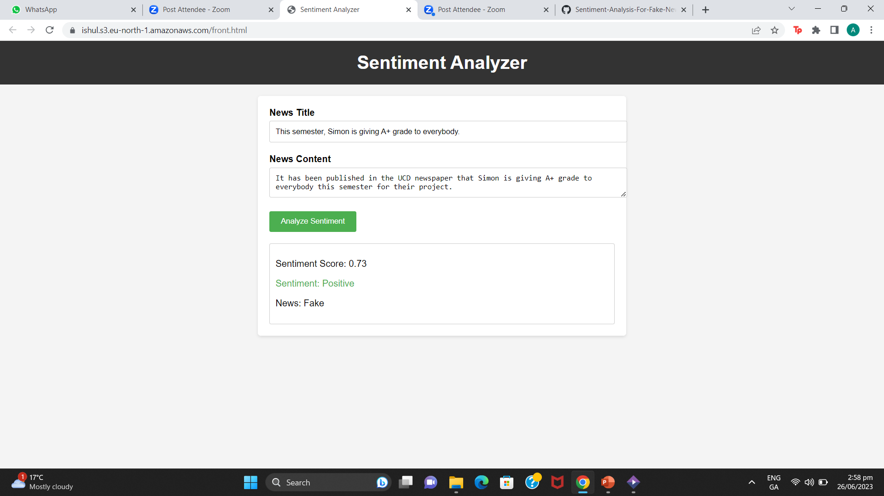
Front- End Development
Text input field for users to enter the news headline and a little description of the news.
Click analyze to initiate the sentiment analysis process.
Uses: NLP techniques to determine whether the sentiment of the headline is positive, negative or neutral.
After sentiment analysis is complete, the application displays the result on screen.

Slide 22
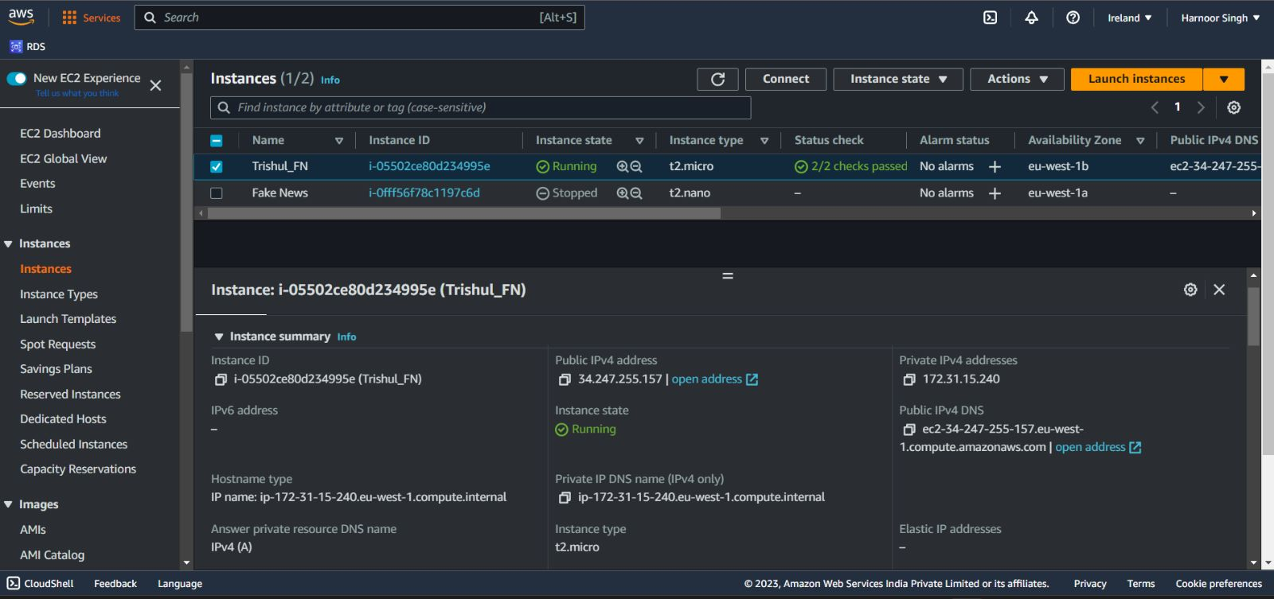
Back-End Development
Created an EC2 instance for deploying our prototype flask app on a public server.

Slide 23
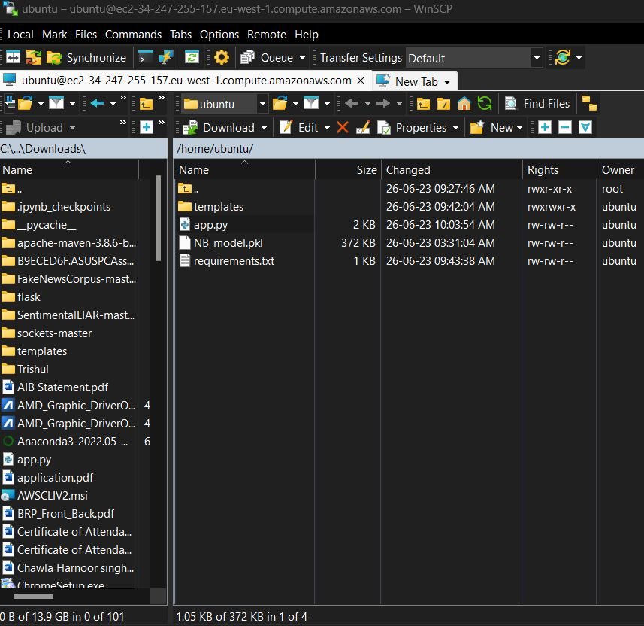
Used a software known as WinSCP to connect our EC2 instances locally and deploying flask app

Slide 24
AWS Services for end-to-end deployment
SageMaker: Fully managed machine learning service, designed to simplify the process of building, training, and deploying machine learning models at scale.
Lambda: Serverless computing service that allows to run our code without provisioning or managing servers.
Route 53: Scalable and highly available Domain Name System (DNS) web service provided by AWS designed to route end users to internet applications by translating domain names into IP addresses.
RDS: Managed database service provided by Amazon Web Services (AWS). Simplifies the process of setting up, operating, and scaling relational databases in the cloud.
S3 (Simple Storage Service): Highly scalable and durable object storage service. Allows storage and retrieval of any amount of data from anywhere on the web.
AWS IAM (Identity and Access Management): Helps manage access to AWS resources by creating users, groups, and roles with specific permissions.

Slide 25
THANK YOU!

